Slide 1

A review of Pushing Serverless to the edge with Webassembly
By Andrew Ealovega

Slide 2
Act I: Background

Slide 3
Background
IoT data is best processed at the edge, due to latency
Traditional cloud paradigms don’t work well with edge controllers however
Thus Serverless computing can be used to provide finer control over resource elasticity
The idea of serverless is that we can scale to zero, as opposed to cloud computings scale upwards to anything. Put another way, serverless focuses on using resources only when demanded
Serverless services usually use docker as their underlying runtime, as it provides relatively lightweight sandboxing
Docker is still relatively heavy however, leading to a latency on function calls known as a Cold Start
There are ways to manage cold starts, however they are not viable on edge compute platforms due to resource constraints

Slide 4
Background: Research Question
This prompts our research question:
“Is Webassembly a viable alternative to docker for serverless, and what benefits can it bring?”

Slide 5
Background: Contributions
The authors claim to make three contributions:
Designing an execution environment for WASM on serverless
An implementation of this idea on Apache OpenWhisk, known as WOW
An evaluation of WOW to determine the viability of WASM

Slide 6
Act II: Preliminaries

Slide 7
Preliminaries: The Serverless Workload
The authors gather a brief survey of research into the nature of serverless workloads
Workloads can be categorized into CPU, IO bound, or mixed
81% of Azure functions are invoked < once per minute
Functions that are accessed frequently however make up 99.6% of all calls
64% of functions are infrequent and scheduled
It can be seen from these facts that serverless workloads are often infrequent and bursty, both of which contribute to cold starts

Slide 8
Preliminaries: The Serverless Workload
Why do infrequent and bursty workloads lead to cold starts?
Docker containers have a spin up time when accessed infrequently
This is caused by the fact that linux needs to setup the namespace facilities for Docker, such as mounts, networks, PID ect. As well as setup the image as a filesystem
Bursty workloads lead to automatic scaling, which involves spinning up many docker containers at once
Combine these for a bad time
So what can be done about cold starts?

Slide 9
Preliminaries: The Serverless Workload
With docker containers, serverless services can keep the containers warm by simply storing them in memory
This obviously uses a lot of resources, which edge platforms don't have
In addition, even on PCs, these are wasted resources that could be used to serve more clients
Thus, we have a goal: Minimize cold start times
If only there was a technology to help with this……..

Slide 10

Preliminaries: Webassembly
Webassembly is an ISA designed to be executed in the browser
Its like assembly - for the web!
Wasm has two main goals:
Serve as the one true compile target for the web, to enable polyglot programming
Go like, really fast (both in load times and execution times)
By default WASM needs to be translated to native code when received
Can be done Just In Time (JIT), or via an interpreter, similar to Python
LLVM has recently added a WASM frontend however, which means that you can compile Wasm to native code akin to normal assembly
The paper refers to this as Ahead Of Time compilation (AoT)

Slide 11
Preliminaries: More Webassembly
So why not just use JVM, CLR ect. bytecode?
Small encoding - WASM is designed to be very compact to send over the internet
Fast decoding - WASM is very fast to decode by design, to lower latencies in the browser
It also supports streaming compilation, where WASM is compiled while it is being downloaded
Sandboxing - WASM is designed with security and sandboxing first
WASM relies on a minimal runtime, in order to reduce attack footprint
Simplicity - WASM is built from the ground up like native asm, so no GC, reflection ect. This means targeting it is just like targeting ARMv6 or something.

Slide 12
How flexible is wasm really?
To really emphasize how effective wasm can be, I like to show this off:
https://d07riv.github.io/diabloweb/

Slide 13
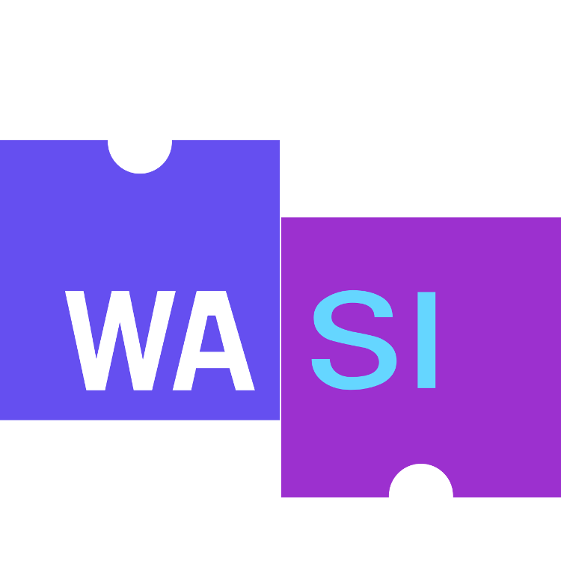
Preliminaries: Webassembly
Recently, there has been a push towards using Wasm out of the browser
This lead to the creation of WASI, basically an OS interface for Wasm akin to the JVM
These runtimes are still massively smaller than the JVM however, mostly just translating instructions and enforcing security
Critically, WASI gives programs permissions based sandboxing akin to apps
This means someone can't upload a function that just immediately runs `rm -rf /`
Ultimately, WASI is what rivals docker for the serverless runtime, not Wasm itself

Slide 14
Act III: Design

Slide 15
Requirements
A good edge serverless system should have:
Fast cold starts
High throughput
Caused by a combination of cold starts and code performance
Polyglot capabilities
Sandboxing to enable multi-tenant use
The ability to run on a variety of ISAs
Webassembly should (in theory) provide all of the above

Slide 16
A stereotypical serverless service
Users hit an API frontend for management of their functions and triggers
A controller takes these requests and manages the underlying resources
When a function should be called, the controller selects an invoker to execute the function on a host using the underlying runtime
Can these invokers be on different machines?
Each runtime shares a common interface, which allows for generic create, init, run, and delete operations
To enable the use of WASM, we will replace the invoker down in the stack.

Slide 17
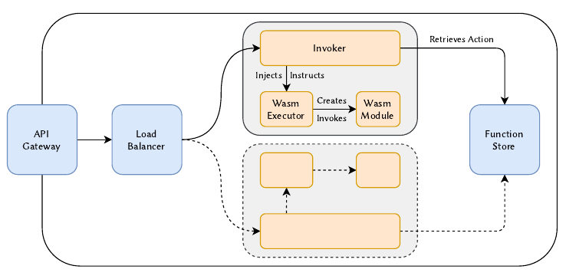
A Wasm runtime

Slide 18
Act IV: Implementation

Slide 19
Wasm Compilation
The authors decided to use AoT compilation on their containers for the following reasons:
Interpreters are too slow
JIT adds ~40ms of lag to cold starts
Unlike the browser, we get the Wasm modules before they need to be executed, so we have time to AoT compile them

Slide 20
Wasm runtime selection
There are many WASI runtimes. The ones considered for this work are:
Wasmtime - JIT compiling runtime for x86 and ARM
Wasmr - Supports JIT and AoT using LLVM
Wamr - Runtime that focuses on AoT memory use
Some alternatives I like:
Wasm3 - An interpreter designed to run on embedded systems
Authors discarded due to interpreter being slow.
Wasmedge - A runtime that goes beyond the WASI standard to support ex. Sockets today.
Not sure why this wasn’t considered, considering it has widespread support

Slide 21
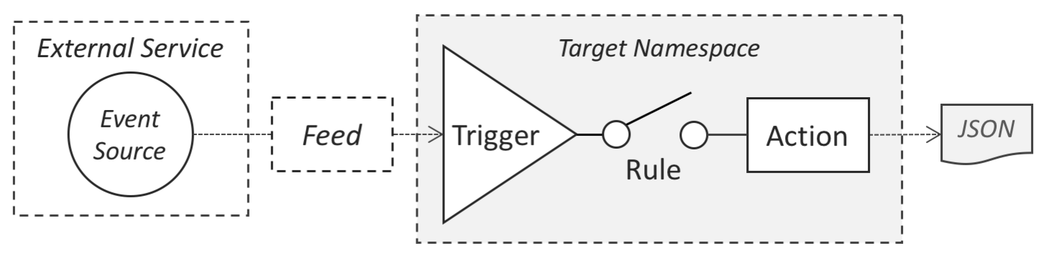
OpenWhisk
The authors choose OpenWhisk as the serverless platform to implement the WASM runtime on, for reasons of accessibility and prominence in research.

Slide 22
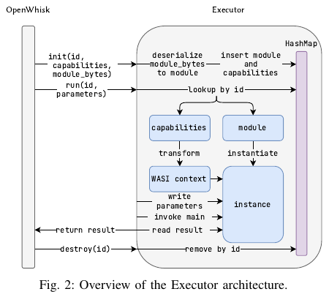
WOW implementation
Written in Rust :)
I like this, this is good
Uses HTTP for endpoints
Generic over WASI runtime
/Init causes a module to be cached in a HashMap
This means re `/run`ning a module repeatedly is cheap
Removed on /destroy
Requests to this executor happen in parallel

Slide 23
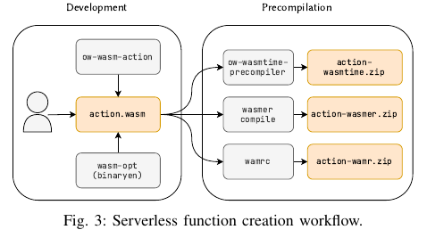
Developer side
User writes an action in a language that compiles to WASI
WASM is optimised
WASM is AoT compiled to target ISA
Only one target ISA?
Result is zipped and uploaded

Slide 24
Act V: Evaluation

Slide 25
Load types
CPU bound - implemented using a hash function
IO bound - sleep to simulate an HTTP request
Tests are run with either of these types, or a mix

Slide 26
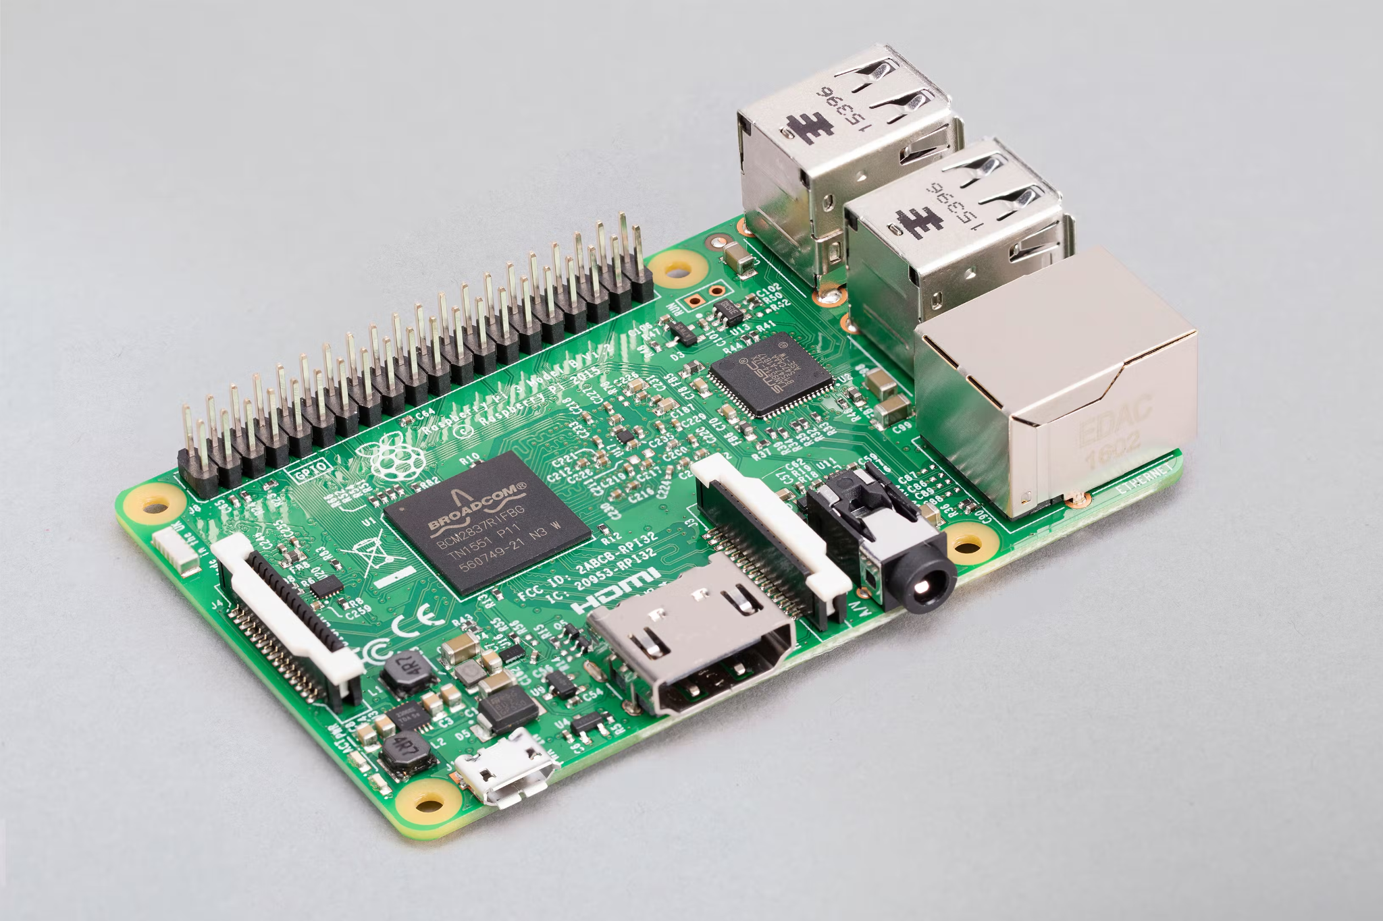
Hardware
Authors test on two different platforms due to edge computes various definitions:
SBC: Raspi 3B
Server: 8GB ram, Xeon, SSD

Slide 27
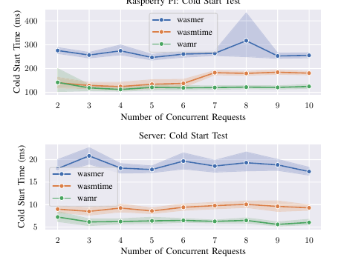
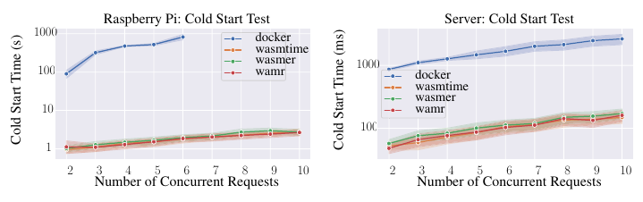
Results: Cold Start
Long story short - Wasm is way faster
Wasm has on average 0.5% of the cold start time of docker
Wamr is the fastest of the Wasm runtimes
What scaling is this graph lol

Slide 28
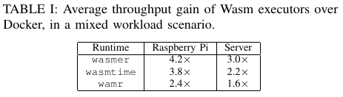
Results: Throughput
Interestingly, the Wasm runtime also has significantly higher throughput than the docker runtime, erring to its lower overhead
The only area where docker has higher throughput is for a repeated CPU bound task, since Wasm has less mature native code than native code in a docker container, and the containers can stay warm

Slide 29
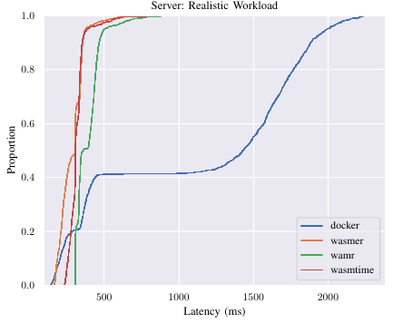
Results: Latency
Latency was tested with a realistic, stochastic workload
This graph is a CDF of the turnaround times for a call
Note that the platu for docker is caused by the massive difference in start time between cold and warm starts
Essentially, a call could either take < 500ms with .4 probability, or take > 1000 with .6 probability

Slide 30
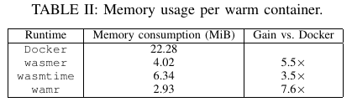
Results: Memory
Unsurprisingly, Wasm is far more memory effective than docker
This means that more modules can be kept in memory at any point in time, increasing throughput
This also helps a lot on SBCs, since memory is scarce

Slide 31
Finale

Slide 32
My thoughts
Overall, I think this paper did a good job at assessing the viability of Wasm on serverless, which is what it set out to do. Mainly:
There is now clear benefits to using wasm at runtime
There is now a working (and open source!) example of integrating Wasm into a serverless platform
It isn’t without its shortcomings, but overall I think this paper set its scope well and stayed within it.

Slide 33
Limitations
WASI is still super immature, and already has some fragmentation problems
Sockets exemplify this
This setup only allows for stateless functions
(mine) The function store needs to store each ISA because of AoT
Wastes space compared to JIT
(mine) WASM can still only be targeted mainly via C, C++, Rust, and TinyGo
As much as I wish everyone used Rust, as per the paper GC languages like node are the most common in serverless, so not supporting them is pretty rough
This could change with enough RFCs to Wasm though

Slide 34
Extensions
I would love to see this idea applied to something like femtoClouds, since it solves many of the problems with that system and its security
In general, I think pretty much any research idea that requires code to be sent over the wire should consider WASM (if not WASI), since WASM itself already provides such a strong ecosystem for running sandboxed code
WASM on IoT devices seems very promising

Slide 35
Addressing some questions
Will wasm have GPU support? - It does in the web. The WASI-NN proposal has a working implementation of GPU accelerated NN inference (by intel). Actual shader programming is proposed, but far off.
Now that docker has WASM support, does this paper matter? - I think so, since it still serves as a basis for why you would use wasm in docker, even if docker itself replaces the runtime described in the paper.

Slide 36
Other resources
A cool InfoQ talk on the web side of this: https://www.infoq.com/presentations/webassembly-edge-wasi/
A production version of this work: https://www.fermyon.com/cloud
Applying these ideas to GraalVM: https://arxiv.org/abs/2212.10131
Another paper on this idea, older than this one: https://arxiv.org/abs/2010.07115
Another runtime by the CNCF that's really taken off (docker has support for this): https://github.com/WasmEdge/WasmEdge

